Slide 1
Lesson 16
Object-oriented programming, classes, attributes, methods
Python Hybrid - Autumn 2024

Slide 2
Overview
Review Classes, Objects, Attributes, Methods
“Special” methods
Exercises

Slide 3
Classes, Objects, Attributes, Methods

Slide 4
Introduction to Object-oriented Programming
Breaks the programming task into objects, which combine data (known as attributes) and behaviors/functions (known as methods)
There are two main components of the OOP: class and object
Used to structure a software program into simple, reusable pieces of code blueprints.
This makes OOP popular among larger development teams, that require easy ways to divide the workload.

Slide 5
Building Blocks
Classes
Objects (Instance of Class)
Methods
Attributes

Slide 6
Variables (Attributes or Properties)
Attributes “hold data”. When modeling your classes think of them as “properties”.
In OOP jargon they’re also known as variables or properties.
When working with classes, we use the following types of variables:
Class Variables
Instance Variables

Slide 7
Data Access and Method Calling
To access instance and class variables (attributes), use the dot notation:
instance_name.attribute
ClassName.attribute
To “run” or execute a method, just call it as a normal function:
instance_name.method()
instance_name.method(arg1, kwarg1=value)
Try it yourself. Create a simple class in an interactive Python session and access its attributes using the above notation.

Slide 8
Class Variables
Will be available for all class instances (objects).
Be careful when using them. They have the similar pitfalls as global variables. Avoid mutable types.
Use them to share “state” among all the class instances.
Important: They must be defined outside the class methods.
class Shark:
species = 'fish' # class variable
def __init__(self, weight):
self.weight = weight # instance variable

Slide 9
Class Variables
class Dog:
tricks = [] # mistaken use of a class variable
def __init__(self, name):
self.name = name
def add_trick(self, trick):
self.tricks.append(trick)
When using this class in an interactive session, you will get the following output:
>>> d = Dog('Fido')
>>> e = Dog('Buddy')
>>> d.add_trick('roll over')
>>> e.add_trick('play dead')
>>> d.tricks # unexpectedly shared by all dogs
['roll over’]
Source: https://docs.python.org/3/tutorial/classes.html#class-and-instance-variables

Slide 10
Instance Variables
class Dog:
def __init__(self, name):
self.name = name
self.tricks = [] # creates a new empty list for each dog
def add_trick(self, trick):
self.tricks.append(trick)
Defined in the __init__ method.
Belongs exclusively to an object (instance).
Cannot be modified by other instances.

Slide 11
Methods
In OOP, methods reflect the “behaviour” of the objects that you’re modeling.
As seen before, it’s a function built into the class that operates on the class attributes.
For example:
A car (object) can accelerate (behaviour).
A client (object) can login (behaviour).
A button (object) can be clicked (behaviour).

Slide 12
Methods
class Dog:
def __init__(self, name, age, breed):
self.name = name
self.age = age
self.breed = breed
def bark(self):
print("wuff-wuff")
benny = Dog("Benny", 2, "Pug")
benny.bark() # prints "wuff-wuff"
method
Method is a function of the class, that can operate on the attributes, changing their values or returning new data depending on them.

Slide 13
Methods
The most important method when working with classes is __init__()
Define all your instance variables inside this method. This will make clear what data your instance needs to function.
Don’t do:
Instead, do:
class Person:
def __init__(self, name, last_name , age):
self.name = name
self.age = age
self.last_name = self.set_last_name(last_name)
self.print_name()
def set_last_name(self, last_name):
self.last_name = last_name # instance var defined outside init
def print_name(self):
print(self.name, self.last_name)
class Person:
def __init__(self, name, last_name, age):
self.name = name
self.last_name = last_name
self.age = age
def print_name(self):
print(self.name, self.last_name)

Slide 14
Methods
During init, you can also call other methods or functions store the result in attributes:
class Square:
def __init__(self, length, width):
self.length = length
self.width = width
self.area = self._calculate_area()
def _calculate_area(self):
return self.length * self.width
In the above example, area is calculated during initialization and stored as an attribute for future use.

Slide 15
Instance and self
class Dog:
def __init__(self, name, age, breed):
self.name = name
self.age = age
self.breed = breed
marley = Dog("Marley", 5, "Golden Retriever")
benny = Dog("Benny", 2, "Pug")
Constructor is defined by the __init__() function + Instance Attributes
Instance / Object
The two use cases of self
Notice that we use the self keyword to specify methods by setting the first parameter to self.
self is also used to refer to attributes and methods owned by the object instance.
Notes:
variable inside __init__ specific to object

Slide 16
Modify Object Properties
class Dog:
def __init__(self, name, age, breed):
self.name = name
self.age = age
self.breed = breed
def bark(self):
print("wuff-wuff")
benny = Dog("Benny", 2, "Pug")
benny.breed = "Golden Retriever"
method
Modify object properties

Slide 17
Delete Object Properties
class Dog:
def __init__(self, name, age, breed):
self.name = name
self.age = age
self.breed = breed
def bark(self):
print("wuff-wuff")
benny = Dog("Benny", 2, "Pug")
benny.breed = "Golden Retriever“
del benny.breed
method
Delete object properties

Slide 18
Delete Object
class Dog:
def __init__(self, name, age, breed):
self.name = name
self.age = age
self.breed = breed
def bark(self):
print("wuff-wuff")
benny = Dog("Benny", 2, "Pug")
benny.breed = "Golden Retriever“
del benny.breed
del benny
method
Delete object

Slide 19
Private Variables
class Foo:
def __init__(self):
self._count = 0
def say_hello(self):
self._count += 1
print('Hello World')
def get_count(self):
return self._count
“Private” instance variables that cannot be accessed except from inside an object don’t exist in Python.
However, there is a convention that is followed by most Python code: a name prefixed with an underscore (e.g. _spam)

Slide 20
Private Variables
class Foo:
__count = 0
def __init__(self):
pass
def say_hello(self):
self.__count += 1
print('Hello World')
def get_count(self):
return self.__count
The use of double underscores is known as “name mangling” and it’s intended to provide an easy way to create private variables or methods in Python.

Slide 21
Pass Statement
class Dog:
pass
benny = Dog()

Slide 22

“Special” Methods

Slide 23
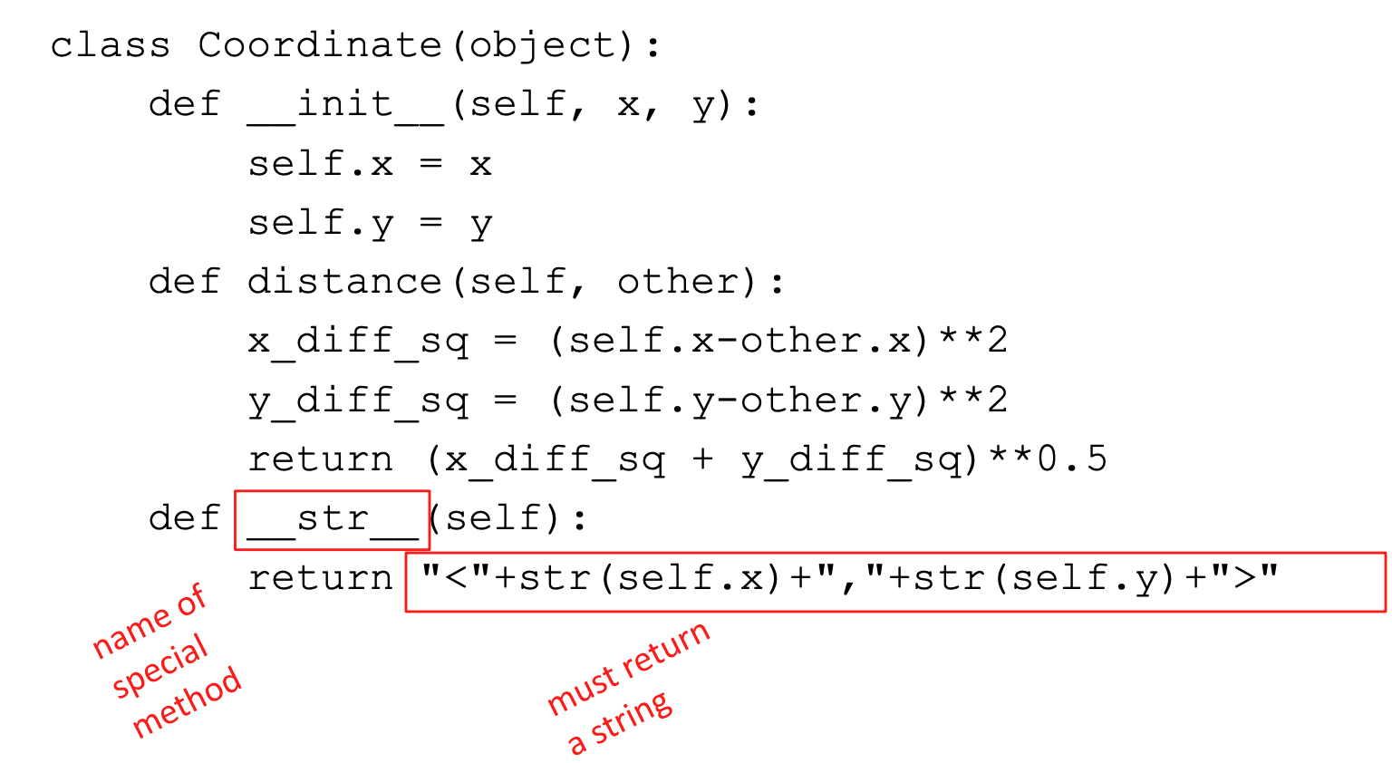
Print representation of an object
uninformative print representation by default
define a __str__ method for a class
Python calls the __str__ method when used with print on your class object
you choose what it does!

Slide 24
Special Methods
class Dog:
def __init__(self, name, age, breed):
self.name = name
self.age = age
self.breed = breed
def bark(self):
print("wuff-wuff")
def __str__(self):
return f"{self.name}, {self.age} years old, {self.breed}"
benny = Dog("Benny", 2, "Pug")
benny.bark() # prints "wuff-wuff"
print(benny) # prints "Benny, 2 years old, Pug"
method
__str__ method

Slide 25
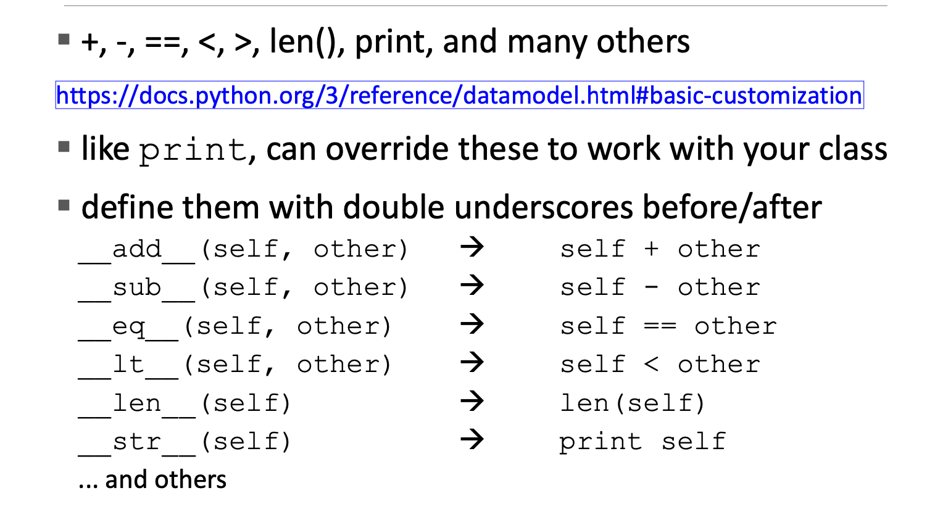
Other special operators

Slide 26
Exercises

Slide 27
Exercise - Circle
Create a Circle class that has one instance variable named “radius”.
Add a method to calculate and print the area of the circle.
The area of a circle is calculated by multiplying Pi by the square of the radius: Pi x r²

Slide 28
Exercise - Circle
Rework your Circle class so that the area is calculated during initialization and stored in an “area” attribute.

Slide 29
Exercise – Triangle
Create a class, Triangle. Initialize instance variables angle1, angle2, and angle3 as arguments.
Create a method named check_angles to calculate the sum of angles. It should return True if the sum of angles is equal to 180, and False otherwise.
If the sum of angles is 180, check if the triangle is equilateral or not. Do this either within the class as a method or as a function outside the class.

Slide 30
Exercise – Vector
Create a class Vector, describing 3-dimentional vectors.
Implement as many special methods as possible.

Slide 31
Exercise – Fraction
Create a class Fraction
Implement as many special methods as possible.

Slide 32
Exercise - Oranges
Create an Orange class that has one class variable named “count” used to track the number of oranges in existence.
All oranges should have a “weight” instance variable.
Create 3 different oranges. Make sure your “count” class variable tracks the count correctly.
Create a separate function (not bound to a class) to add the weight of each orange and get the result.

Slide 33
Exercise – Lunch Menu
Define a class called Lunch.
Define menu as an instance variable where menu is a string.
Add a method called menu_price. It will involve an if statement:
if "menu 1" print "Your choice:", menu, "Price 12.00",
if "menu 2" print "Your choice:", menu, "Price 13.40", else print "Error in menu".

Slide 34
Exercise - Bank Account
Write a BankAccount class that works like specified:
Steps:
Store the current value of the BankAccount in an attribute named balance (that should start with 0)
Add a deposit method that receives a value and adds it to balance and prints balance
Add a withdraw method that receives a value and subtracts it from balance and prints balance

Slide 35
Exercise - Bank Account (2)
Keep developing your BankAccount class.
Add a movements attribute to your class that should be an empty list to start.
Every time deposit or withdraw methods are called, this movement should be added to movements (eg: deposit(50) should append “DEPOSIT 50” to movements)
Add a method print_movements to print all the movements
Notes:
WHAT happend Spring 2020

Slide 36
Exercise - Bank Account (3)
Keep developing your BankAccount class.
When the balance is negative (when withdraw method is called), a warning should be printed to the user. Create a display_warning method in your class to do it.
Notes:
WHAT happend Spring 2020

Slide 37
Exercise - Bank Account (3)
Keep developing your BankAccount class.
Add a minimum_balance attribute to your instance (should be 0 by default), and a method to update this value (set_minimum_balance)
Change the warning check (from exercise 1.) to be shown when balance <= minimum_balance
Notes:
WHAT happend Spring 2020

Slide 38
Complete the following exercises
https://www.codewars.com/kata/64c766dd16982000173d5ba1
https://www.codewars.com/kata/587f1e1f39d444cee6000ad4
https://www.codewars.com/kata/58587905ed1b4dad6e0000c6/python
https://www.codewars.com/kata/5631ac5139795b281d00007d
https://www.codewars.com/kata/528d36d7cc451cd7e4000339

Slide 39
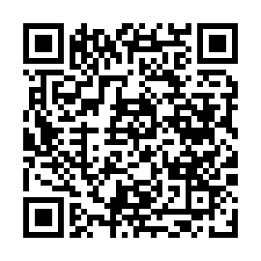
Before you go…
Please take 2 minutes to give us feedback on today’s lesson.
This feedback is anonymous and only seen by the DCP team!
Scan the QR code or go to: https://redischool.typeform.com/lessonfeedback

Slide 40
Thank you for your attention!
See you next class!

